Slide 1
OPERATING SYSTEMS
OVERVIEW

Slide 2
OPERATING SYSTEM OVERVIEW
WHAT IS AN OPERATING SYSTEM?
An interface between users and hardware - an environment "architecture”
Allows convenient usage; hides the tedious stuff
Allows efficient usage; parallel activity, avoids wasted cycles
Provides information protection
Gives each user a slice of the resources
Acts as a control program.

Slide 3
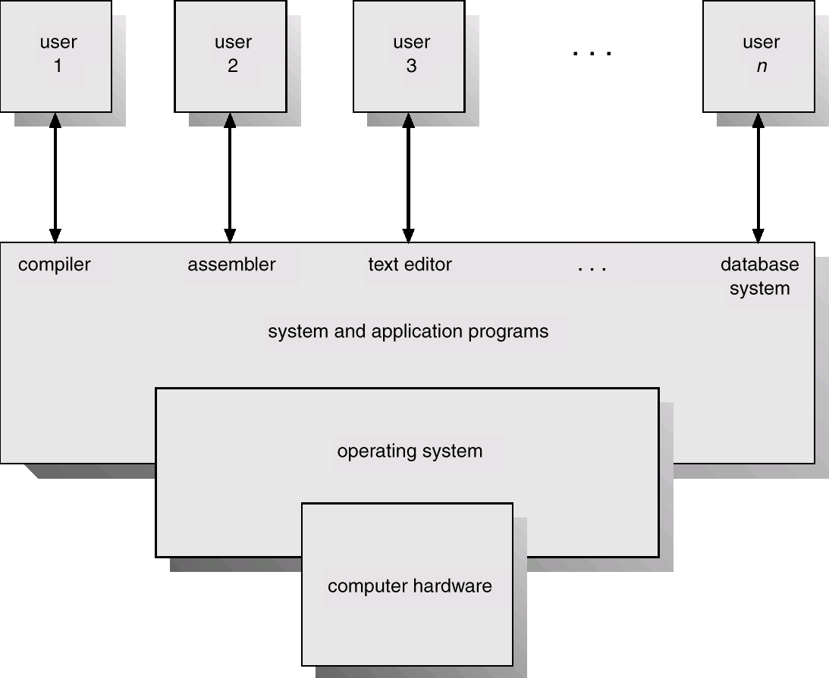
OPERATING SYSTEM OVERVIEW
The Layers Of A System
Humans
Program Interface
User Programs
O.S. Interface
O.S.
Hardware Interface/ Privileged Instructions
Disk/Tape/Memory

Slide 4
OPERATING SYSTEM OVERVIEW
Components
A mechanism for scheduling jobs or processes. Scheduling can be as simple as running the next process, or it can use relatively complex rules to pick a running process.
A method for simultaneous CPU execution and IO handling. Processing is going on even as IO is occurring in preparation for future CPU work.
Off Line Processing; not only are IO and CPU happening concurrently, but some off-board processing is occurring with the IO.

Slide 5
OPERATING SYSTEM OVERVIEW
Components
The CPU is wasted if a job waits for I/O. This leads to:
Multiprogramming ( dynamic switching ). While one job waits for a resource, the CPU can find another job to run. It means that several jobs are ready to run and only need the CPU in order to continue.
CPU scheduling is the subject of Chapter 6.
All of this leads to:
memory management
resource scheduling
deadlock protection
which are the subject of the rest of this course.

Slide 6
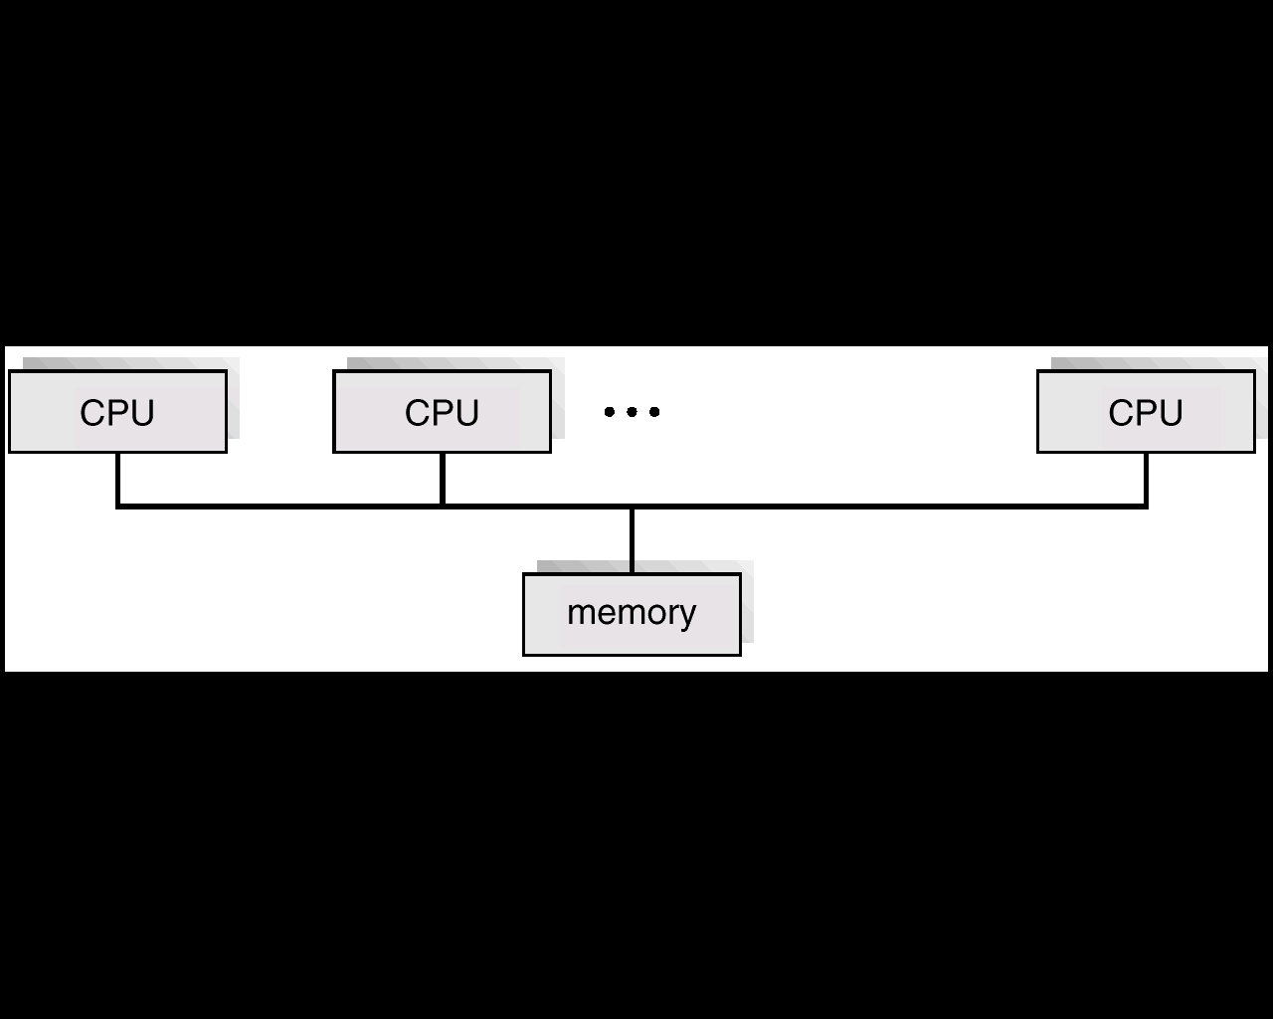
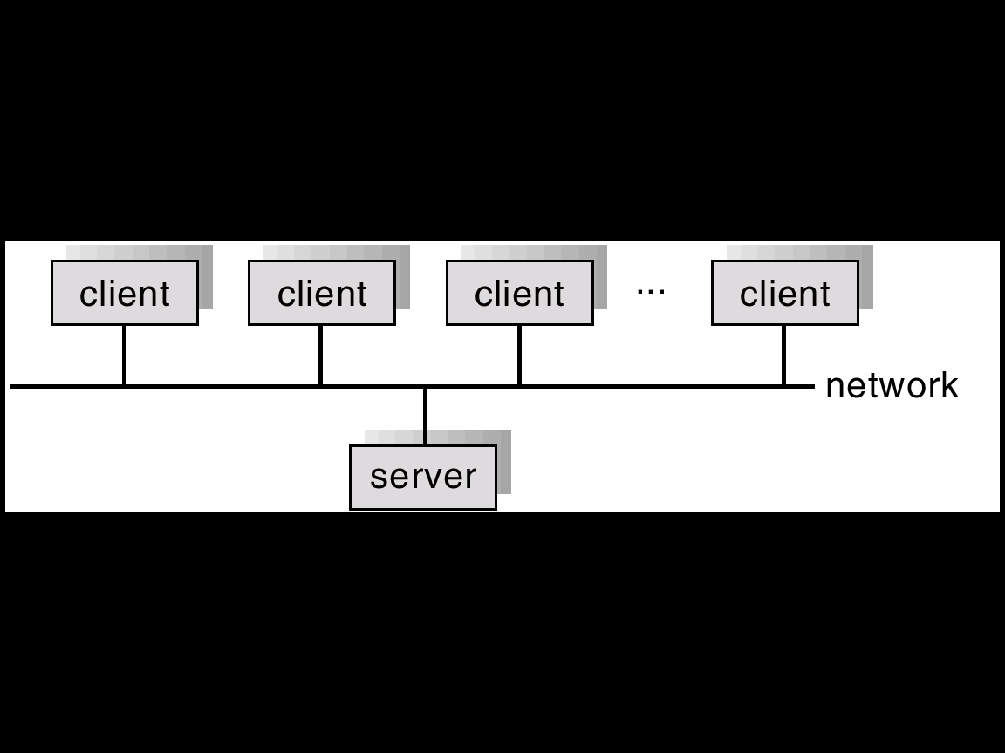
OPERATING SYSTEM OVERVIEW
Characteristics
Other Characteristics include:
Time Sharing - multiprogramming environment that's also interactive.
Multiprocessing - Tightly coupled systems that communicate via shared memory. Used for scientific applications. Used for speed improvement by putting together a number of off-the-shelf processors.
Distributed Systems - Loosely coupled systems that communicate via message passing. Advantages include resource sharing, speed up, reliability, communication.
Real Time Systems - Rapid response time is main characteristic. Used in control of applications where rapid response to a stimulus is essential.

Slide 7
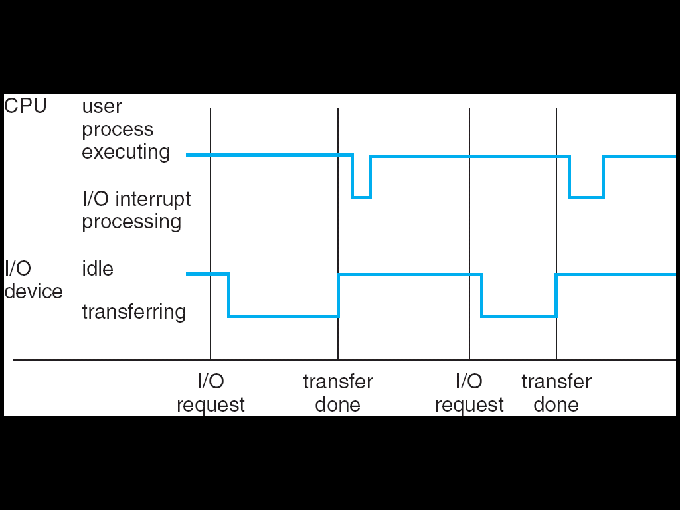
OPERATING SYSTEM OVERVIEW
Characteristics
Interrupts:
Interrupt transfers control to the interrupt service routine generally, through the interrupt vector, which contains the addresses of all the service routines.
Interrupt architecture must save the address of the interrupted instruction.
Incoming interrupts are disabled while another interrupt is being processed to prevent a lost interrupt.
A trap is a software-generated interrupt caused either by an error or a user request.
An operating system is interrupt driven.

Slide 8
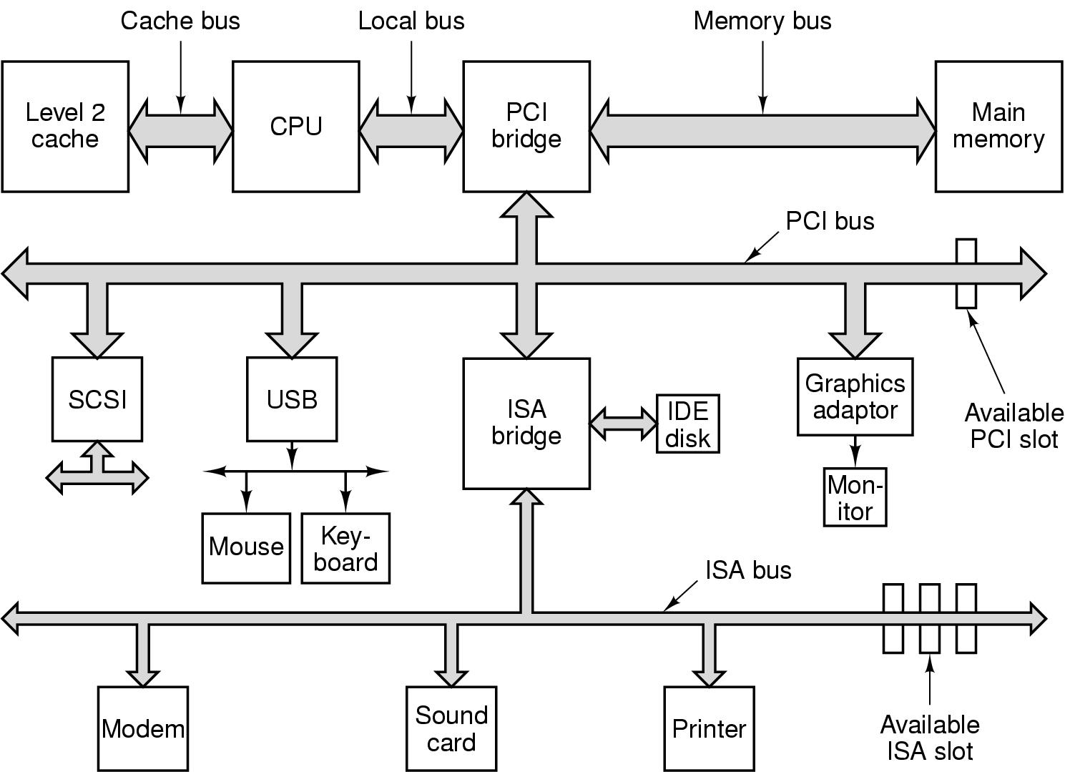
OPERATING SYSTEM OVERVIEW
Hardware
Support
These are the devices that make up a typical system.
Any of these devices can cause an electrical interrupt that grabs the attention of the CPU.

Slide 9
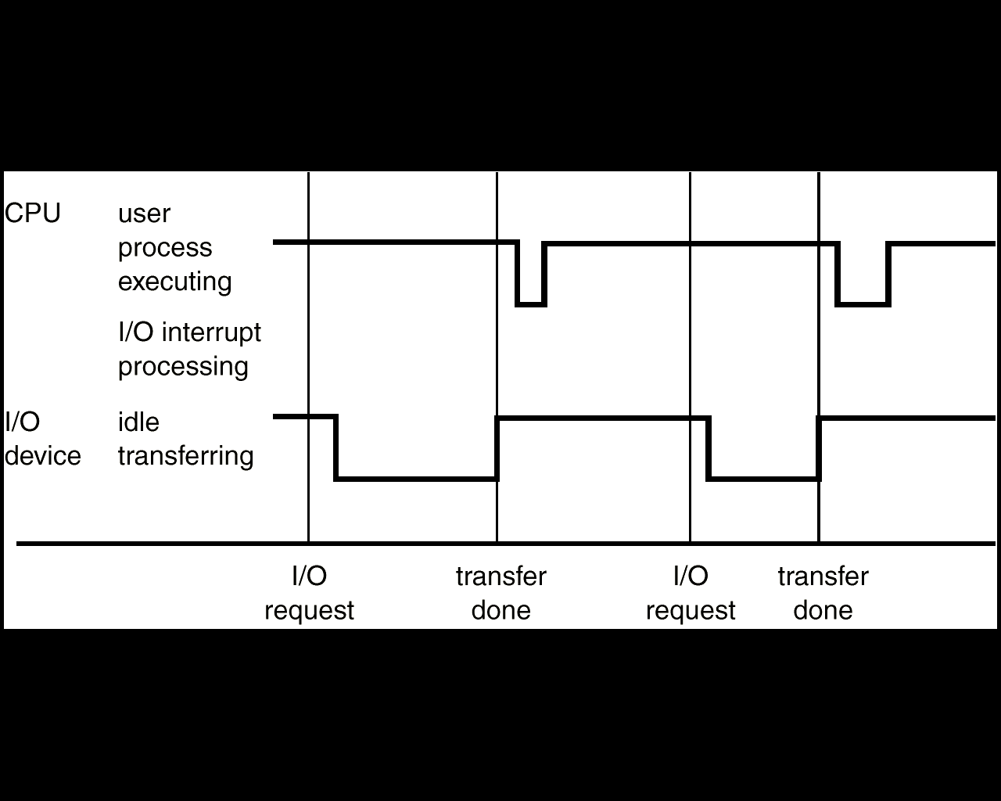
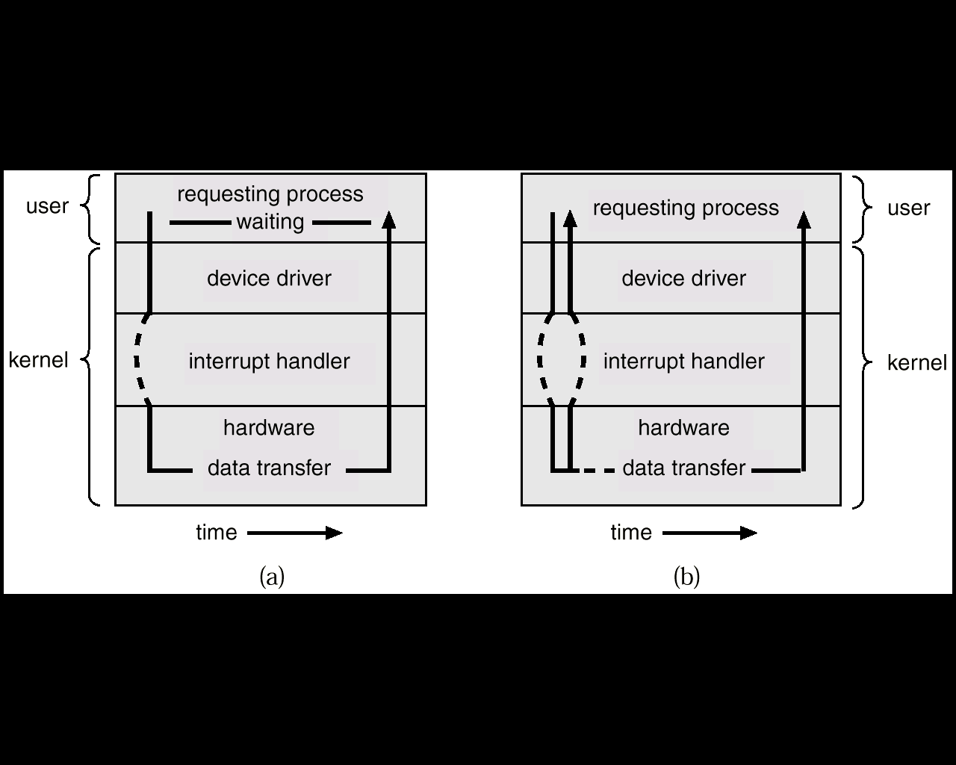
OPERATING SYSTEM OVERVIEW
Hardware
Support
Sequence of events for processing an IO request.
Comparing Synchronous and Asynchronous IO Operations

Slide 10
OPERATING SYSTEM OVERVIEW
Storage
Hierarchy
Caching:
Important principle, performed at many levels in a computer (in hardware, operating system, software)
Information in use copied from slower to faster storage temporarily
Faster storage (cache) checked first to determine if information is there
If it is, information used directly from the cache (fast)
If not, data copied to cache and used there
Cache smaller than storage being cached
Cache management important design problem
Cache size and replacement policy

Slide 11
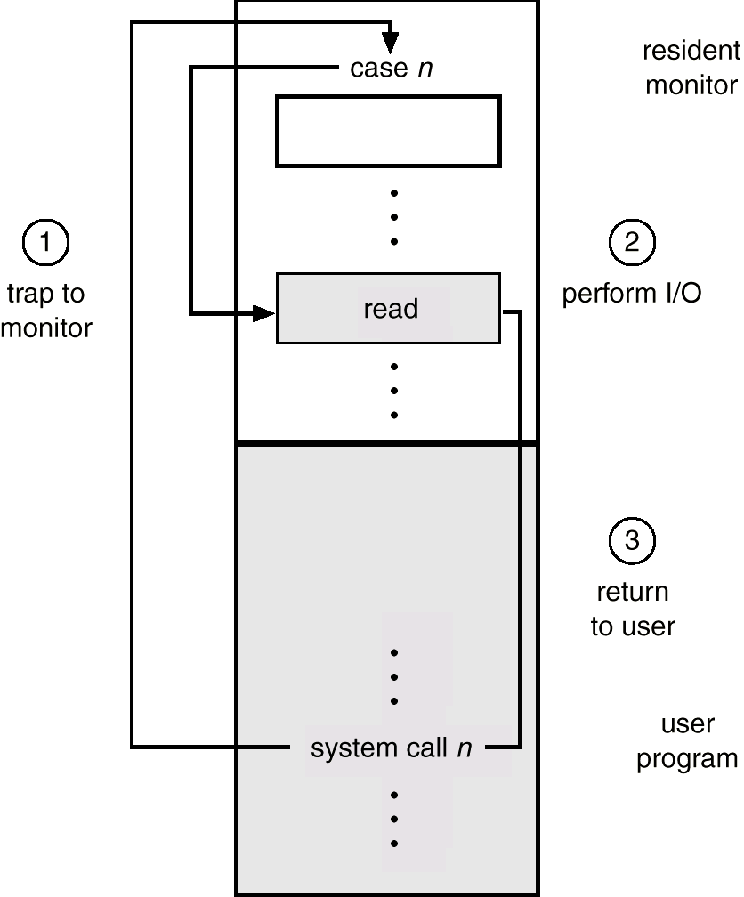
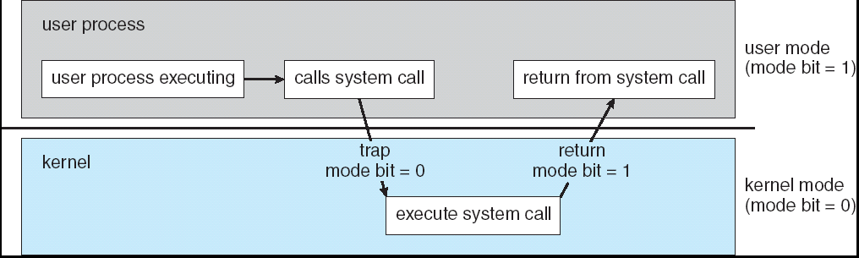
OPERATING SYSTEM OVERVIEW
Protection
The goal is protecting the Operating System and others from malicious or ignorant users.
The User/Supervisor Mode and privileged instructions.
Concurrent threads might interfere with others. This leads to protection of resources by user/supervisor mode. These resources include:
I/O Define I/O instructions as privileged; they can be executed only in Supervisor mode. System calls get us from user to supervisor mode.

Slide 12
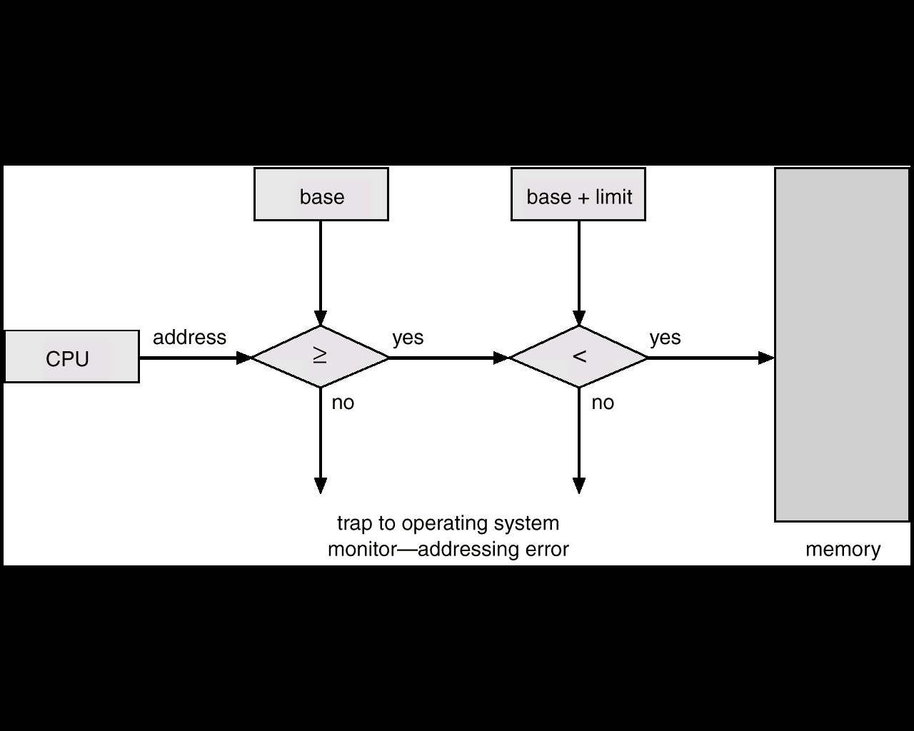
OPERATING SYSTEM OVERVIEW
Protection
Memory A user program can only access its own logical memory. For instance, it can't modify supervisor code. Depends on an address translation scheme such as that shown here.

Slide 13
OPERATING SYSTEM OVERVIEW
Protection
CPU A clock prevents programs from using all the CPU time. This clock causes an interrupt that causes the operating system to gain control from a user program.
For machines connected together, this protection must extend across:
Shared resources,
Multiprocessor Architectures,
Clustered Systems
The practice of this is called “distributed operating systems”.

Slide 14
WRAPUP
OPERATING SYSTEM OVERVIEW
We’ve completed our first overview of an Operating System – this was the equivalent of a Satellite picture.
The next view will be at the level of a high flying plane.
After that, we’ll be at ground level, looking at pieces in detail.

